Slide 1
Student Performance Analysis
DSC478
Ramadan Gannud
Maaz Bin Aftab

Slide 2
Introduction
Higher education standards for the 21st century continues to promote discoveries in the field through learning analytics (LA)
The purpose of this study is to examine American students’ Math and Reading scores in relevance to number of students and financial expenditures to identify groups exhibiting common patterns of responses

Slide 3
Techniques
Linear Regression
Principle Components Analysis
Logistic Regression

Slide 4


Data Sources
U.S. Census Bureau
National Center for Education Statistics (NCES)

Slide 5
Data Structure
All American public schools for 25 years (1993-2017)
25 variables and 1492 observations
'ENROLL' feature represents the U.S. Census Bureau data value (financial data)
'GRADES_ALL' represents the NCES data value (demographic data)

Slide 6
Missing Data
This dataset suffers from many missing data ( 72% of rows )
263 rows are with more than 50 % missing values
Our target variables suffered from missing values the most
Row deletion was the best way to keep track of our target
Rows with missing values, zeros, and duplicated rows
Our New data structure ( 403 observations X 22 variables )

Slide 7
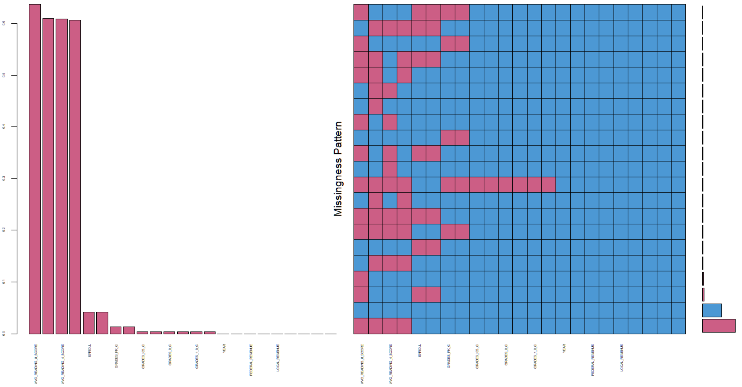
Missing Data Patterns

Slide 8
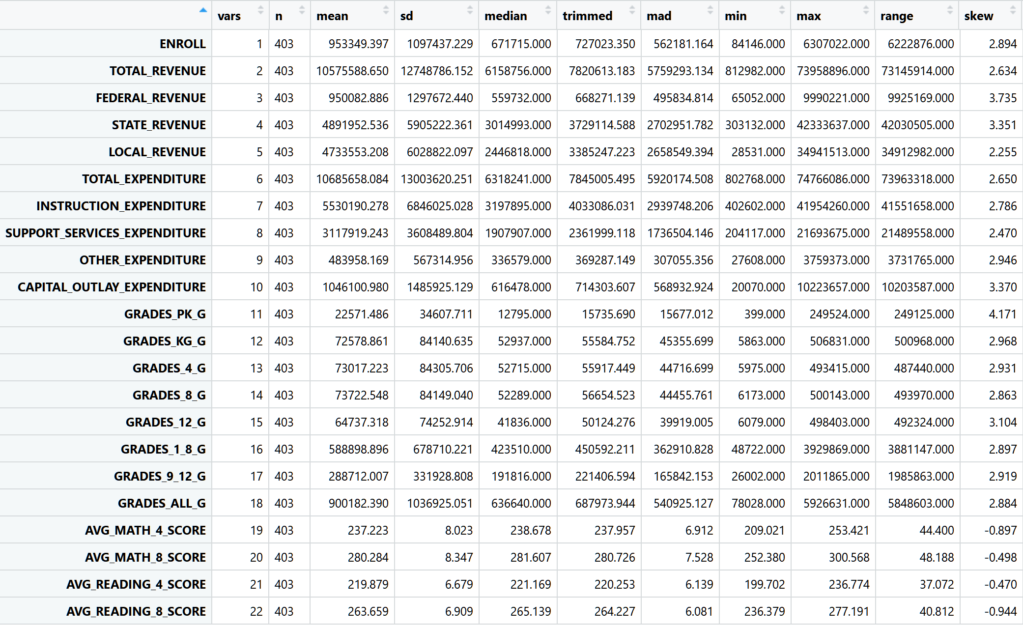
Descriptive Analysis

Slide 9
Descriptive Analysis Cont
Eighth grader students’ performance is better than fourth graders
High positive correlations between the 8 enrollment features
High positive correlation between the 9 financial features
The 8 enrollment features are clearly correlated with the 9 financial features
High correlations between 3 of the target student scores features
Average Reading scores for 8 graders has no linear relationships with other scores

Slide 10
Principle Component Analysis
It was implemented in R using correlation and covariance
high bi-variate correlation matrix provides components
Factor Analysis keep only components with correlated variables and large corresponding eigenvalues
Resulting correlation matrix is determined using the product of the matrices of eigenvectors and the square root of the eigenvalues
The communality for a variable is the sum of squared loading (SSL) across components

Slide 11
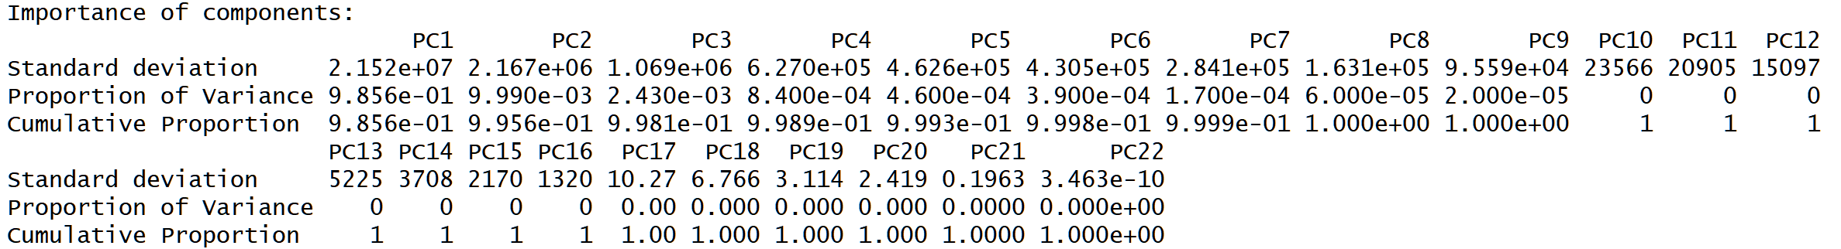
PCA Process 1
Initialize and extract communalities for different variables variances that accounted for different factors
Communalities are the proportion of variance for each variable by the rest of the variables
The importance for different using prcomp in R

Slide 12
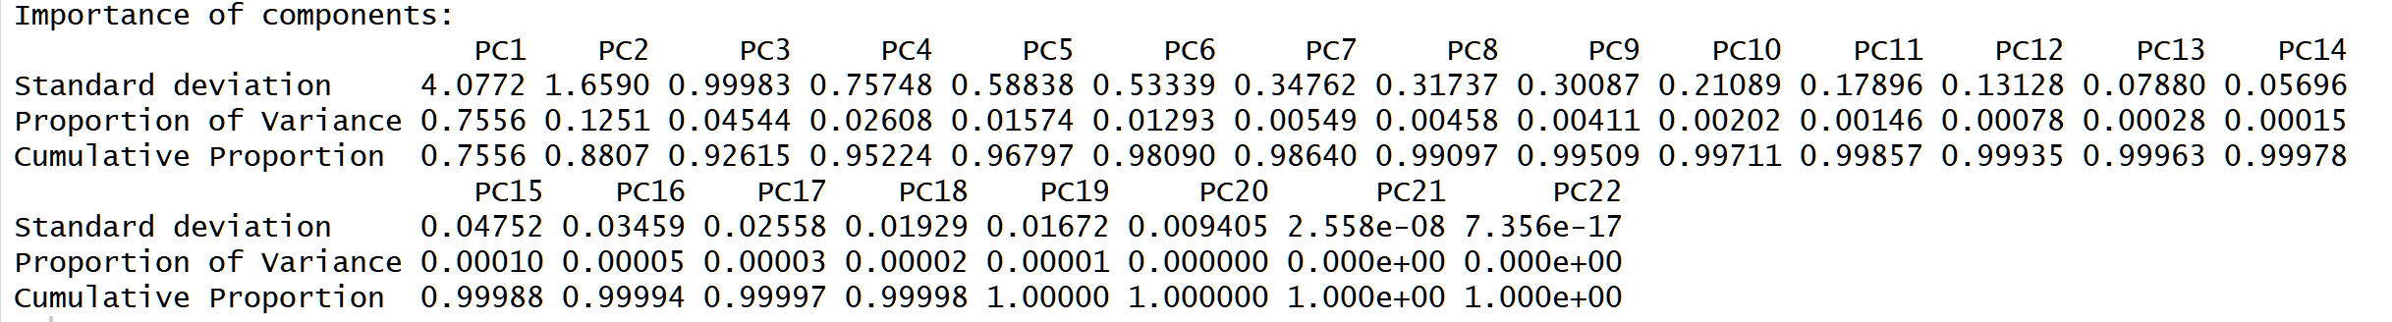
PCA process 2
conducting PCA with the correlation matrix using TRUE scale
PCA on correlation is much more informative and reveals some structure in the data and relationships between variables
The proportion of variances have changed as follow

Slide 13
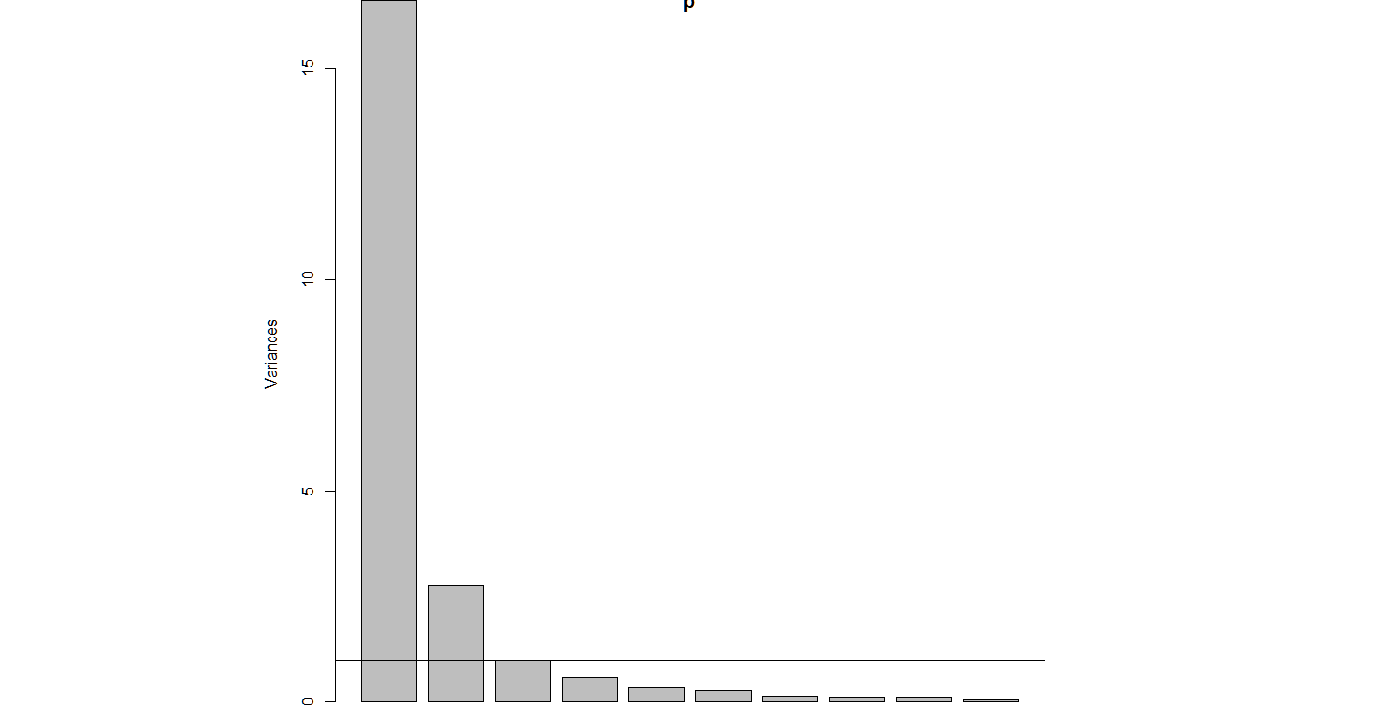
PCA Process 3
Using scree plot helps determine number of components

Slide 14
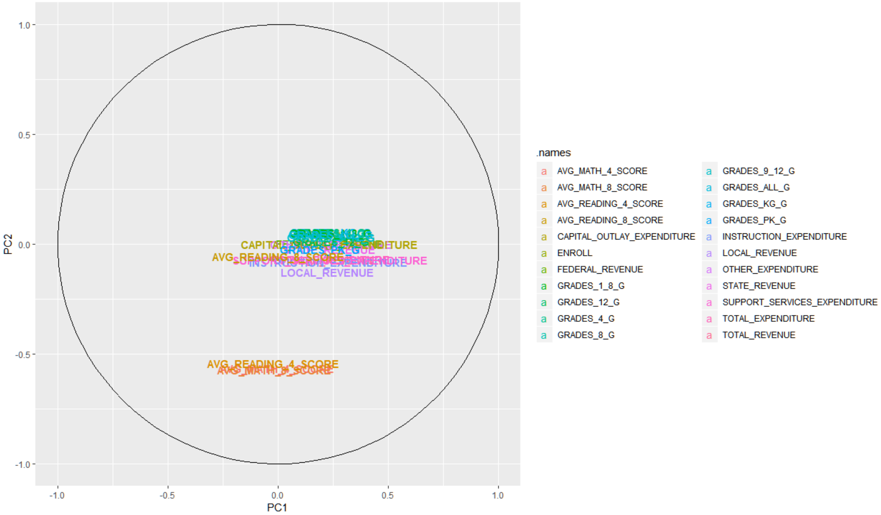
PCA Process 4

Slide 15
PCA Solution
Factors that have small variances do not fit in the principle components solution
Only the first two components should be retained
Factor with large eigenvalues are kept for the analysis
Rotate the components matrix using varimax so the component loading matrix shows the correlation between components and variables
Using a cutoff of 0.4 reveals strong correlation between components and their respective variables

Slide 16
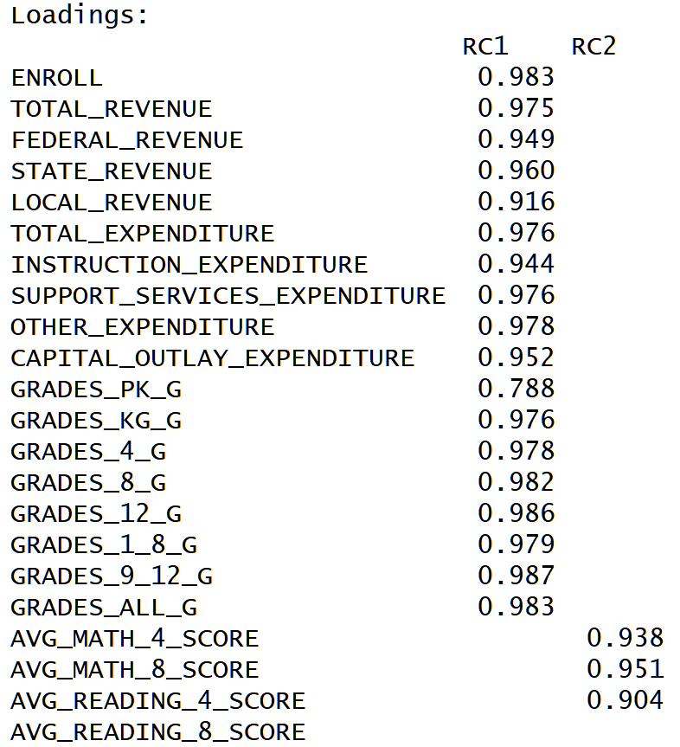
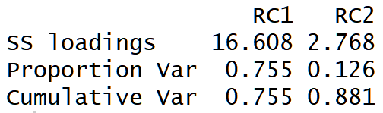
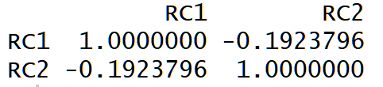
Results
The proportion of variance explained by the 2 components is 88% as follow
The score correlation matrix shows an insignificant negative relationship between both components as follow

Slide 17
Regression Analysis
Relationships between different independent and the dependent variable
goal of multiple regression is to fit a straight line to a points so squared standard deviations of the observed values from that line are minimized
least square’s estimation method

Slide 18
Methodology
The line is basically a two-dimensional space that is define by the equation Y= a + b*X.
Multivariate analysis line could not be visualized in 2d Y = a + b₁*X₁ + b₂*X₂ + ... + b_{p}*X_{p.}
R squared is equal to 1 minus the ratio of residual variability
Coefficient of determination measures the proportion of variance in the independent variables explained by the dependent variable.

Slide 19
Assumptions
There must be a linear relationship between the outcome variable and the independent variables
Multivariate Normality : Multiple regression assumes that the residuals are normally distributed.
Homoscedasticity : that the variance of error terms are similar across the values of the independent variables. A plot of standardized residuals versus predicted values can show whether points are equally distributed
Multicollinearity : Multiple regression assumes that the independent variables are not highly correlated with each other.

Slide 20
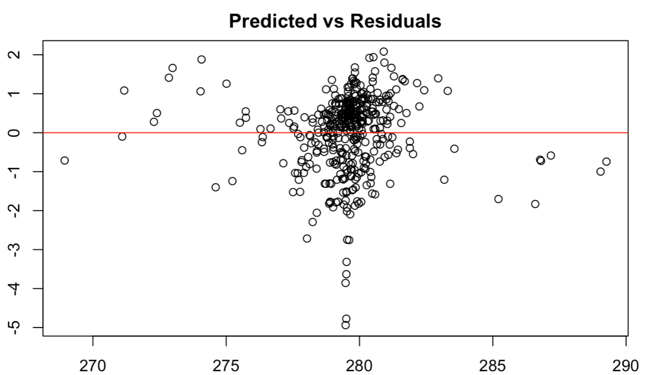
Normality

Slide 21
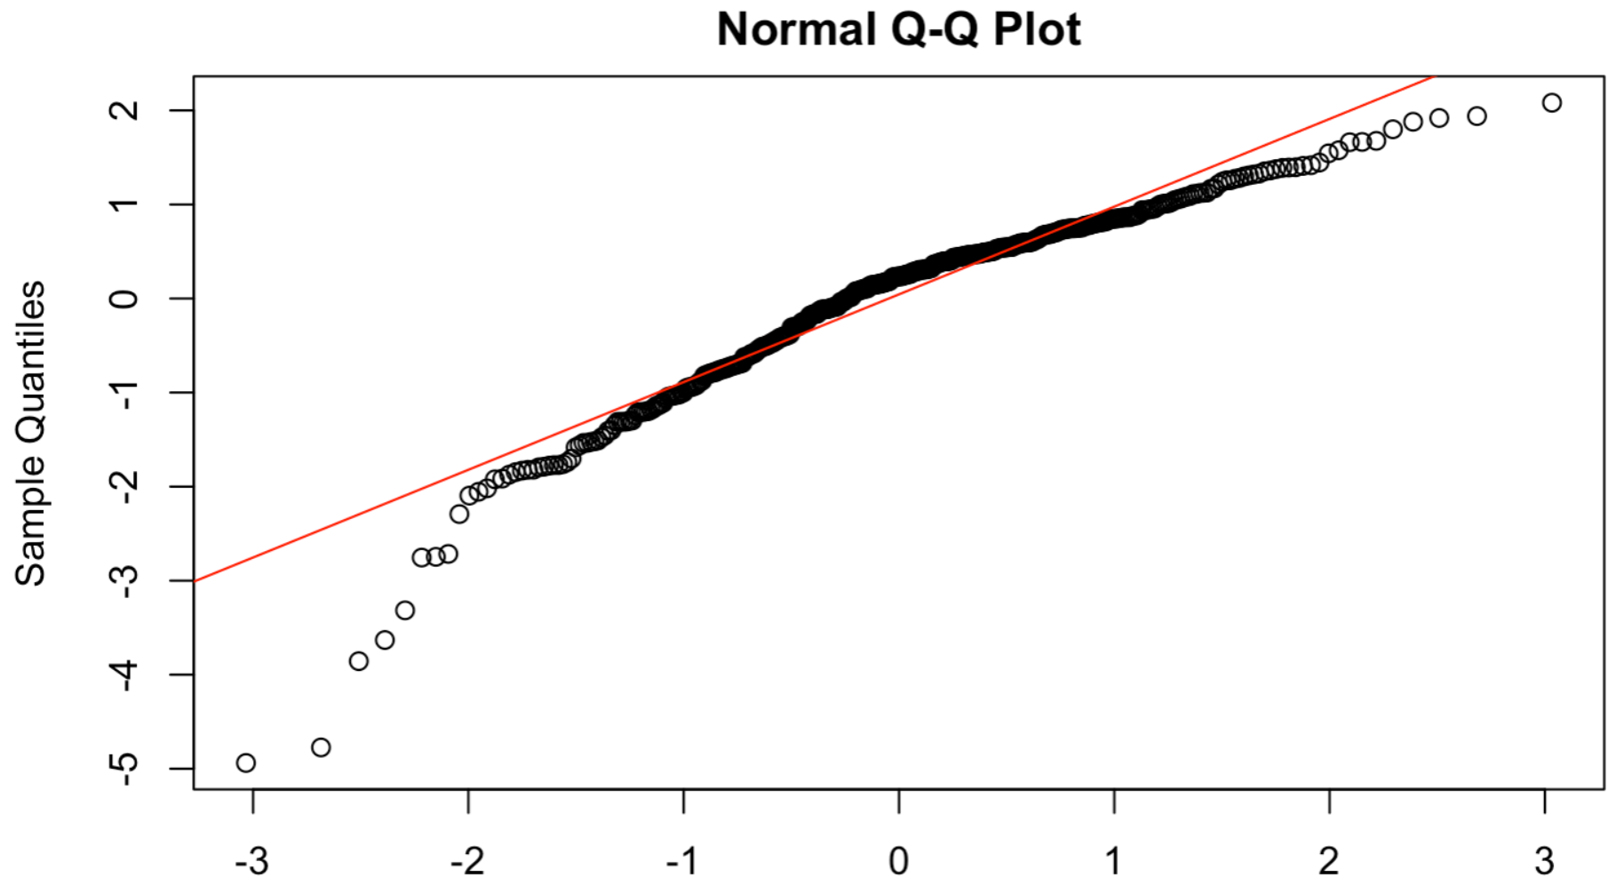
Normality

Slide 22
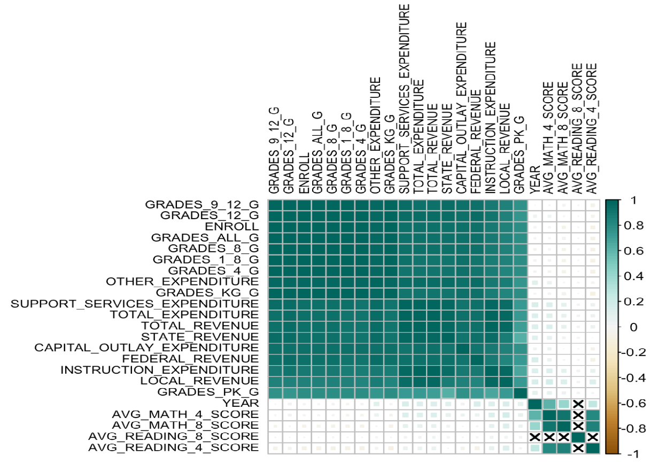
Correlation Plot

Slide 23
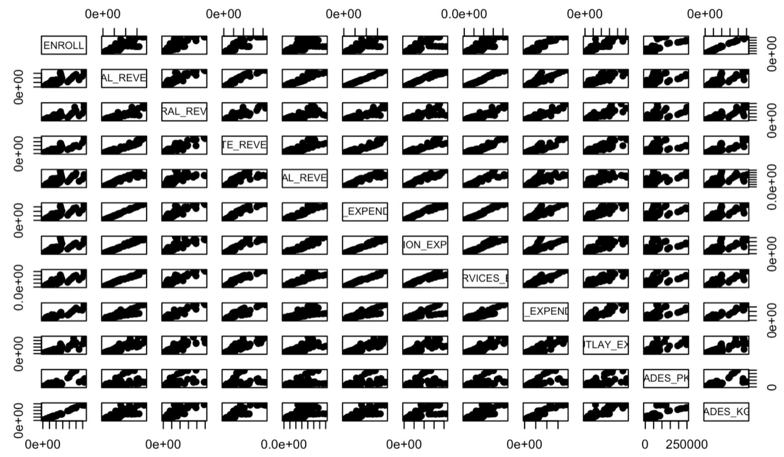
Collinearity

Slide 24
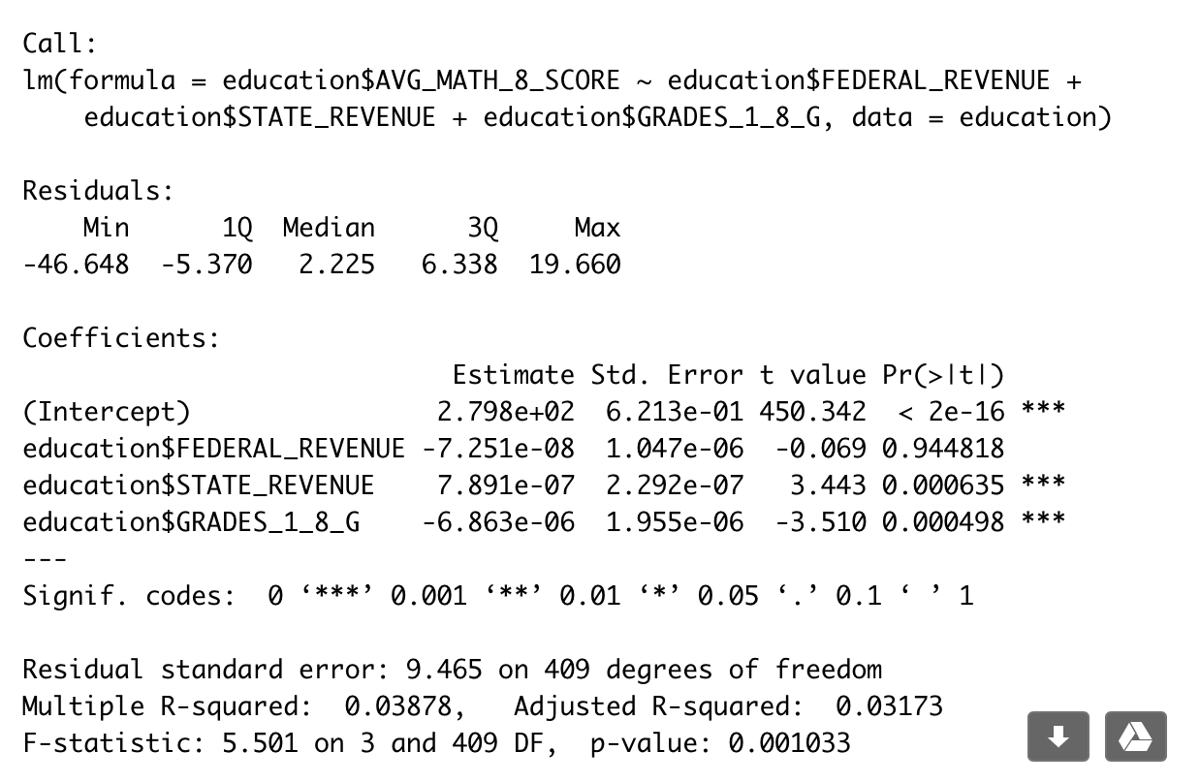
Model 1

Slide 25
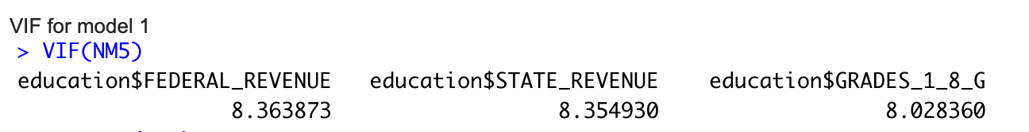
Multicollinearity

Slide 26
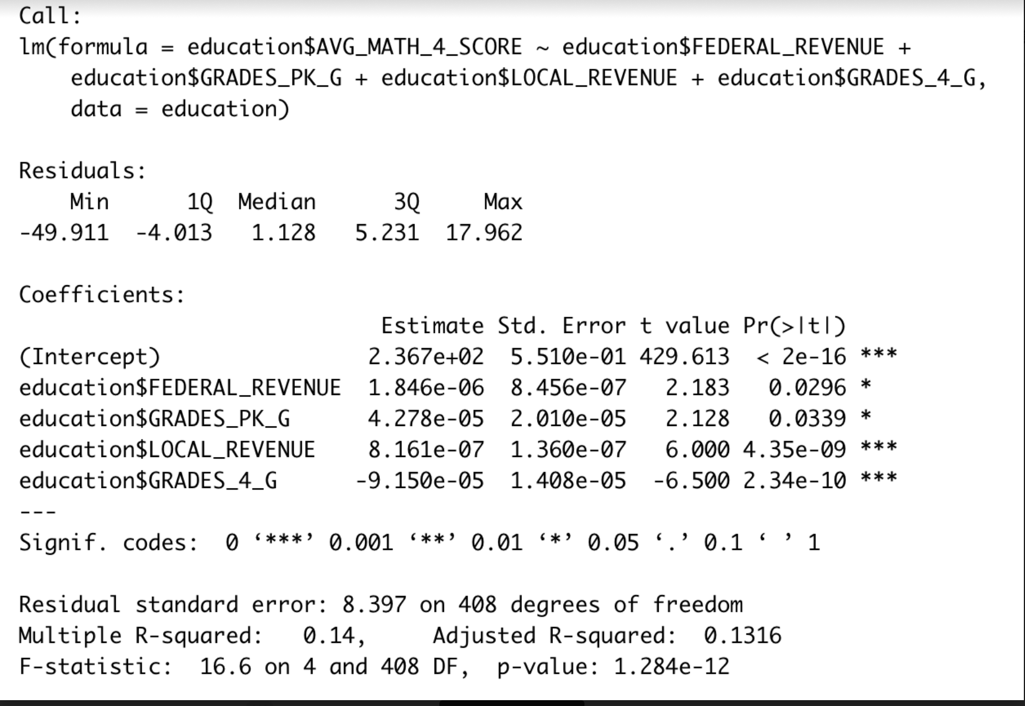
Model 2

Slide 27
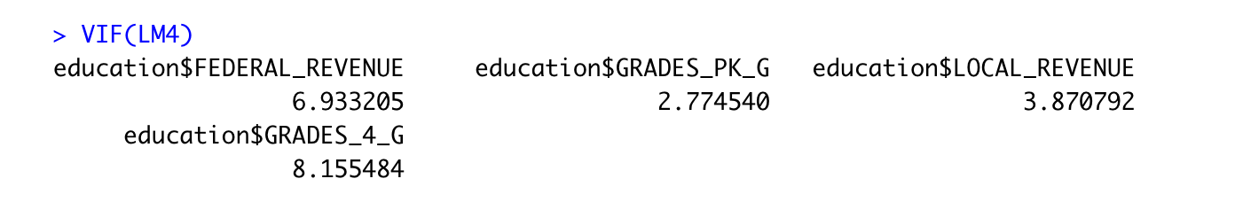
Model 2

Slide 28
Conclusion
Multiple regression analysis was able to identify different predicting variables that could cause noticeable impacts yet small on the average math scores for students in different states
The financial status and the numbers of students’ enrollments in each state played a vital role in determining the students’ academic performance.
PCA explains that the more student enrollments there are, the more the population is and the higher the financial income and expenditures are.
The two components adequately describe the correlation matrix and 88.6% of the variance were explained by the model

Slide 29
Thank You :)

